Slide 1
Additional Slides from Computer Networks by Tanenbaum and Wetheral

Slide 2
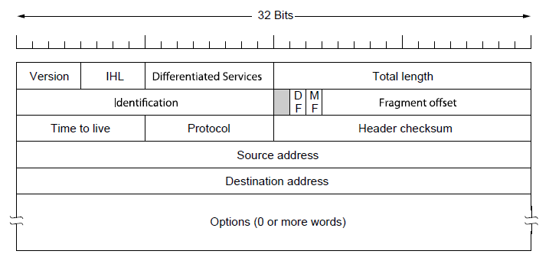
The IP Version 4 Protocol (1)
The IPv4 (Internet Protocol) header.

Slide 3
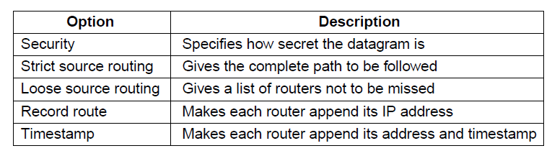
The IP Version 4 Protocol (2)
Some of the IP options.

Slide 4
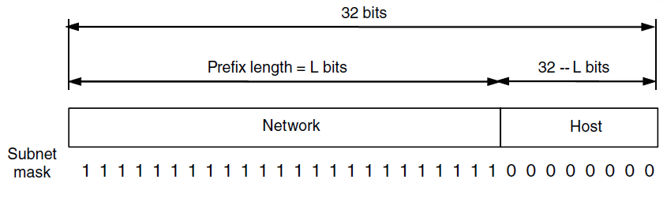
IP Addresses (1)
IP addresses are written in dotted decimal notation like 128.208.2.51
An IP prefix.

Slide 5
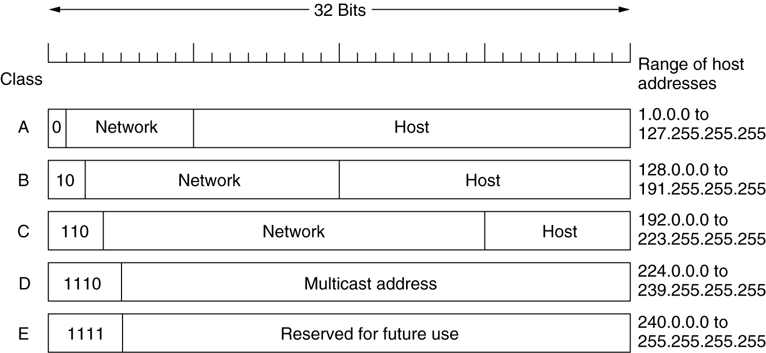
IP Addresses
A: 128 networks with 16 million hosts
B: 16384 networks with 64K hosts
C: 2 million networks with 256 hosts
IP address formats.

Slide 6
Subnets
Hard to put all hosts on a single network.
Soln: Split a network into smaller parts (subnets) for internal use which still acts like a single network to the outside world
Subnetting is not visible outside the network.

Slide 7
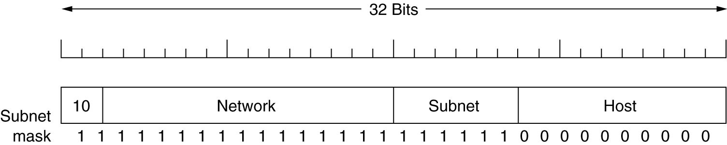
Subnets
Host number in the IP packet is partitioned into (subnet+host)
Ex: A class B network subnetted
into 64 subnets.

Slide 8
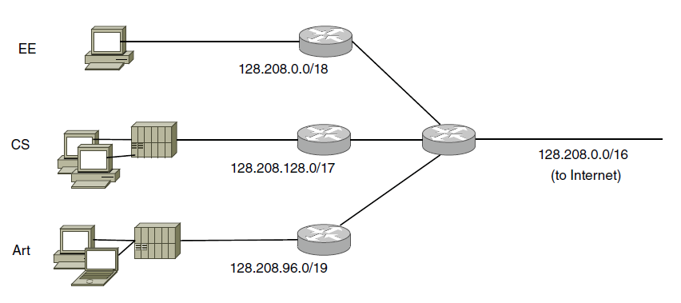
IP Addresses (2)
Splitting an IP prefix into separate networks with subnetting.
Outside the network, subnetting is not visible.

Slide 9
CIDR- Classless InterDomain Routing
Aim is to reduce the size of the routing tables.
Default entry is possible for outgoing link. However, a university router must have an entry for each of its subnets.
The problem is worse for ISPs.
To reduce the size of the routing tables we can apply the same insight like subnetting.
We combine the addresses with the same prefixes into a single prefix, called route aggregation.

Slide 10
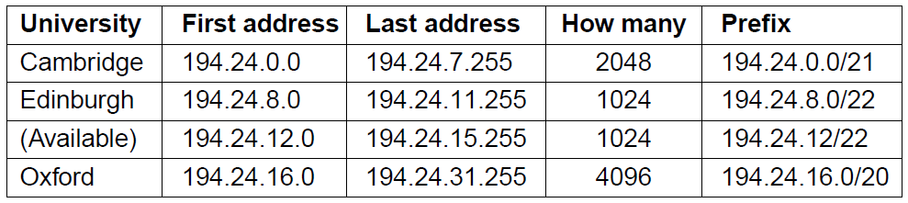
IP Addresses (3)
A set of IP address assignments

Slide 11
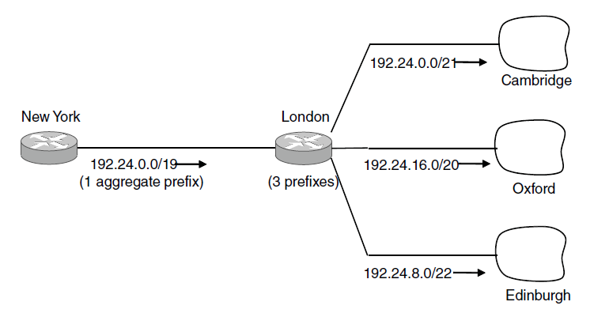
IP Addresses (4)
Aggregation of IP prefixes

Slide 12
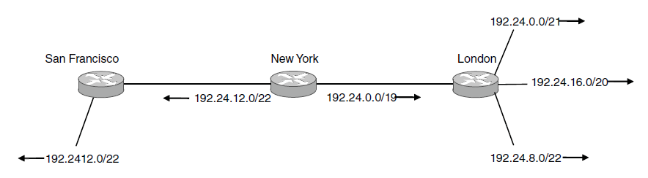
IP Addresses (5)
Longest matching prefix routing at the New York router.

Slide 13
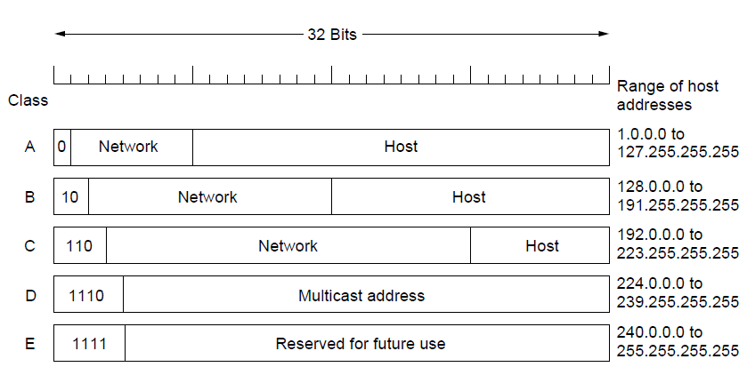
IP Addresses (6)
IP address formats

Slide 14
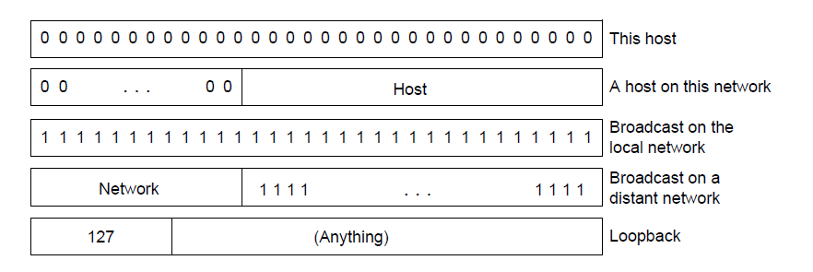
IP Addresses (7)
Special IP addresses

